Slide 1
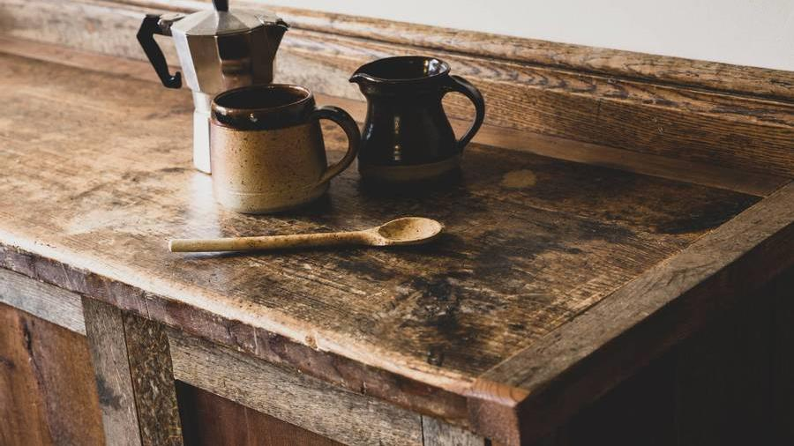
Bright Coffee Shop ^{Sales Analysis}

Slide 2


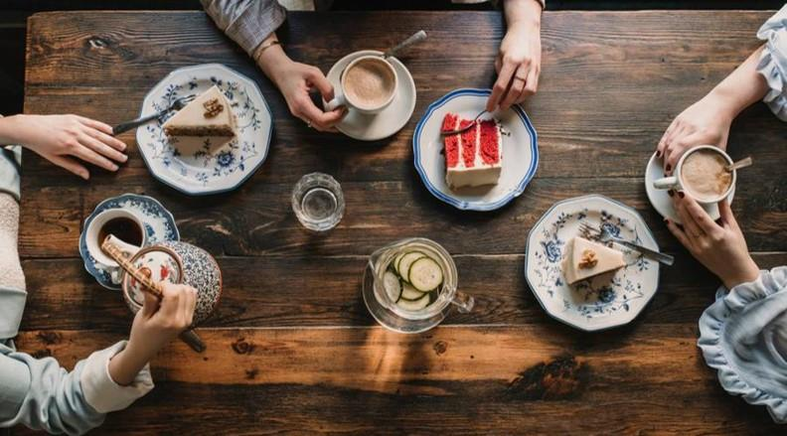
Introduction
Bright Coffee Shop is an upmarket coffee shop selling a wide variety of beverages and delicious baked goods.
The store currently has three locations.

Slide 3

Total Sales R698 812.33

Slide 4
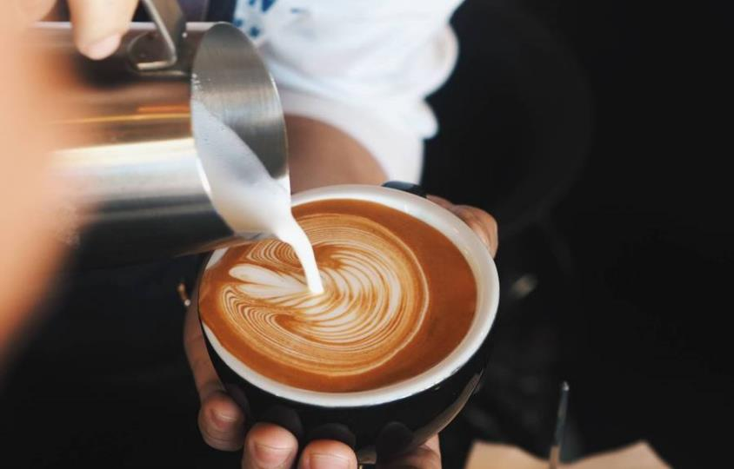
Chart

Slide 5

-Our Stores-
Asotoria
Hell’s Kitchen
Lower Manhattan

Slide 6

Total Sales per Store

Slide 7


Total Sales per Product

Slide 8


20XX
8

Slide 9
Introduce lunch time specials to boost afternoon sales Branded products are expensive to produce but sales are low. A loyalty program targeted at branded products can be introduced to increase sales.
Recommendations

Slide 10

Thank you
John – Junior Data Analyst
john@brightcoffee.com
www.brightcoffee.com

